Slide 1
Theoretical physics dept new http://teor.cfi.lu.lv Current research projects
2 theoretical laboratories—
Vertical and/or horizontal (CAMART)
Experimental activities (A.Popov)

Slide 2
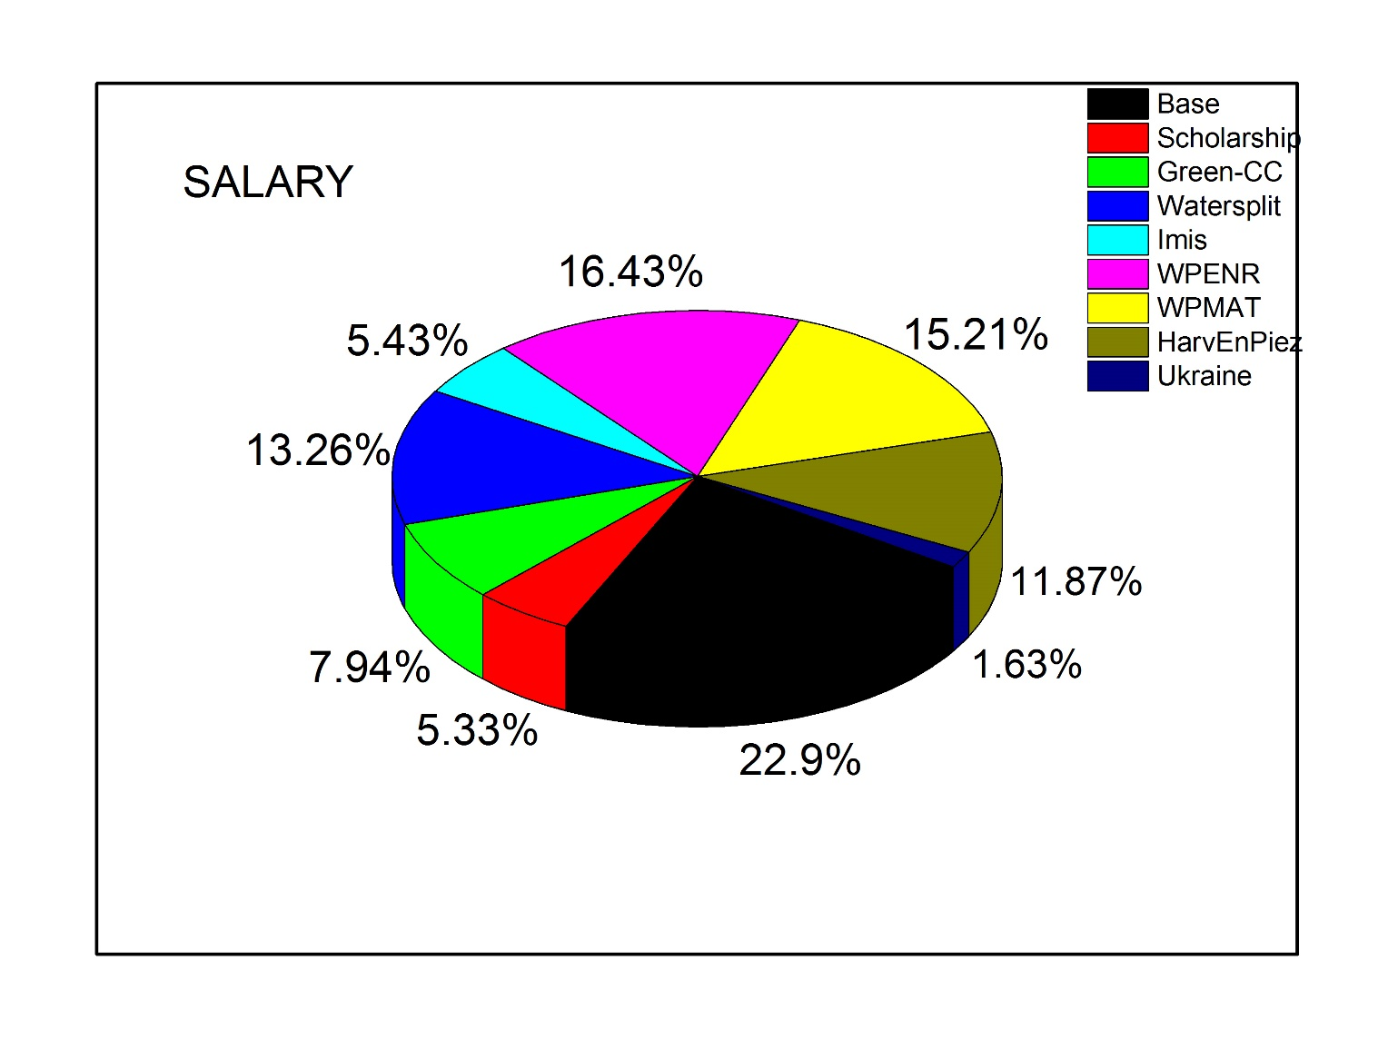
Salary 2017

Slide 3
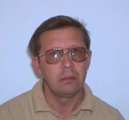
Latvian project
Materials science (2014-2017)
MultIfunctional Materials and composites, photonics
and nanotechnology (IMIS2)
The realization of the program will develop knowledge base in photonics, nanotechnology, innovative and advanced materials as well as enhance human resources and improve the competitiveness of the state economy according to the European Commission Key Enabling Technologies in the areas where Latvia possesses high scientific potential and demand of the economy.
CFI leader A.Sharakovskis, dept PI -A.Popov
A.Popov, R. Eglitis, E. Klotins
Optical properties of ceramics;
Surface properties – expt & theory
No more ESF (young reserchers) or ERAF projects

Slide 4
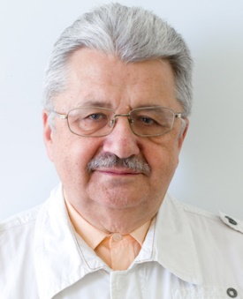
ERA-NET Projects
Watersplit (2016-2018)
Computer modeling of nanostructured photo-catalysts for efficient hydrogen production from water
The main goal of our project is to elaborate a reliable approach for the prediction of the band structure of doped nanostructured photocatalysts through large-scale quantum chemical calculations based on density functional theory (DFT). Our approach will take advantage of fast prediction for defect-induced mid-gap energy levels by means of hybrid DFT, while time-dependent DFT allows the investigation of photoexcited electron transfer processes at the water/photocatalyst interface. The applicability of the proposed approach will not be limited to the rational design of photoelectrodes for redox reactions in water splitting, but also aids the molecular-level understanding of various aspects of interfacial charge transfer in molecular electronics, photovoltaics, electrolysis, catalysis, photochemistry, and photosynthesis.
Leader -Yu. Zhukovski, partners Germany and Russia
R. Eglitis, S. Piskunov, J. Shunin, D. Bocharov,
Gopeenko, A. Platonenko, …
ZnO nanowires, TiO2, WS2; CRYSTAL, NWChem

Slide 5
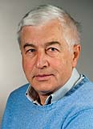
M-ERA-NET Project
HarvEnPiez (2016-2019)
Innovative nano-materials and architectures for integrated piezoelectric energy hardvesting applications
The most efficient way to harvest electrical energy from mechanical movements is to utilize the piezoelectricity of ferroelectrics. In the HarvEnPiez project, the influence of shape and size on the piezoelectricity of ferroelectric particles will be predicted by ab-initio calculations. Different ferroelectric particles with defined sizes and shapes of plates, cubes and/or wires will be synthesized and systematically selfassembled on a substrate for the energy-harvesting devices. A high-performance device will be developed based on the optimized composition, shape, size and orientation of the ferroelectric particles and/or the enhancement of the piezoelectricity through lattice-strain engineering.
Leader –E. Kotomin, partners Slovenia and Romania
V. Kuzovkov, G. Zvejnieks, L. Rusevich, D. Gryaznov, …
Nano-particles and heterostructures (Ba,Sr)TiO3, Ba(Ti,Zr)O3→ CRYSTAL code; self-assembling effects
Kick off meeting 22.03.2017 !

Slide 6
FP7 Energy
Green-CC (2014-2017)
Graded Membranes for Energy Efficient New Generation Carbon Capture Process
GREEN-CC will provide a new generation high-efficiency CO2 capture process in power plants and cement etc industry. However, highly permeable membrane materials show a chemical instability against CO₂ and other flue gas components. One major challenge faced by GREEN-CC is therefore to identify and develop membrane materials, components for OTM integration. The desired membrane assembly will consist of a thin membrane layer supported on substrates with engineered porosity and oxygen reduction catalysts with high and stable activity in flue gas. As proof of concept, a planar membrane module will be developed which involves technical hurdles like joining technology.
Dept. Leader –E. Kotomin, 10 partners including SHELL, cement industries
D. Gryaznov, A.Chesnokov, Yu.Mastrikov….
CRYSTAL, VASP codes
BSCF, LSCF, LSF, LSM ABO3-type perovskites
Possible succesor HORIZON 2020 project on proton+oxygen
Ceramic membranes for chemical industries

Slide 7
EUROfusion
Enabling Research (2015-2017)
When and how ODS particles are formed? –
X-ray Absorption Spectroscopy and ab initio modelling of ODS steels
ISSP has coordinated and collaborated with another EUROfusion members, Karlsruhe Institute of Technology (KIT, Germany) and CEIT-IK4 (Spain), in a EUROfusion project aimed at better understanding formation of oxide nanoparticles in the ODS steels. X-ray absorption spectroscopy measurements have been carried out at international synchrotron radiation facilities for ODS steels samples, produced by KIT, CEIT-IK4, and for model materials produced in ISSP. The aim is to obtain unique information regarding local structure of atoms in oxide nanoparticles in ODS materials and to find when and how oxide nanoparticles are formed.
In parallel kinetic Monte-Carlo modelling of oxide nanoparticle formation and growth is performed and supporting ab initio calculations of Y-O clusters and defects in iron matrix are accomplished. This model will be validated with X-ray absorption spectroscopy and other experimental data.
CFI leader A. Anspoks, Dept – E. Kotomin
J. Mastrikov, A. Gopeenko, G. Zvejnieks,
E. Kotomin, V. Kuzovkov
Ab initio (Y2O3 particles in Fe matrix) and kMC

Slide 8
EUROfusion
Functional materials
WP-15-PPPT-MAT (2015-2018)
Computer modelling of radiation damage in MgO, Al2O3, MgAl2O4 spinel under different types of irradiation (electrons, protons, ions, neutrons)
Radiation resistant insulating materials are important components of the future fusion reactors, including elements of diagnostics, coating etc. Study of radiation damage in these materials are of special importance. In this project related to topic of MATERIALS in Eurofusion activities, we focus on several promising materials, first of all, Al₂O₃ (sapphire). Our activities (2014-2018) will combine first principles atomistic modeling of primary radiation defects and their basic properties, and the kinetics of radiation damage and metal colloid formation under powerful radiation.
Leader – E. Kotomin
A.Popov, Yu. Zhukovskii, V. Kuzovkov, A.Platonenko….
Ab initio calculations of defects and recombination kinetics

Slide 9
Cooperation programme
Latvia-Ukraine (2017-2018)
Jauniem radiācijas dozimetriem paredzētu nanostrukturētu YAlO₃:Mn keramiku izgatavošana, raksturošana un un datormodelēša
Zinātnieku grupas Dr. A.Popova (Latvijas Universitātes Cietvielu fizikas institūts) un Dr. S.Ubizska (Nacionālā Universitāte “Lviv Polytechnic”, Ukraina) vadībā
Leader – A. Popov
R. Eglitis, …
Optical properties of ceramics

Slide 10
Ph D and related activities
A. Chesnokov – CeO2:Tb, Green project
+ LU stipend
A. Platonenko – Al2O3; Eurofusion FM
and FePt nanoparticles- CFI project 2017
A. Gopejenko- ODS; ER project and PZT CFI project 2016
D. Bocharov CFI project 2017
on MD Cu3N and ZnO and post doc ?? 2017

Slide 11
Not enough Synergy ?
38 papers in 2017 for 20 people- not so bad but could be better; remember SNIP!
many similar materials in different projects → closer cooperation (e.g. ZnO for photocatalysis and transparent conducting electrodes)
transfer of accumulated experience (e.g. MD + CP2K)

Slide 12
CAMART2
additional projects expected → people, topics?
collaboration with other depts (horizontal lab.)

